Slide 1

Air Safety
Julia Cuellar
DSC 640

Slide 2
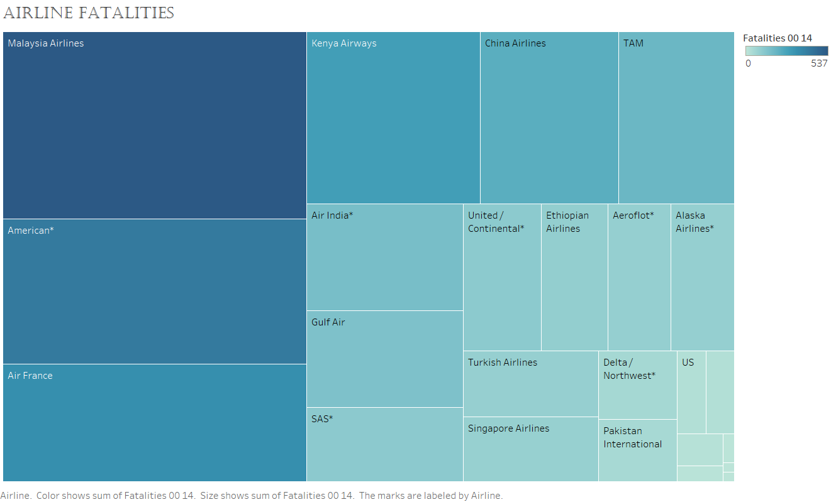
Incorporates More non-US airlines Having a higher fatality rate compared to that of US airlines.

Slide 3
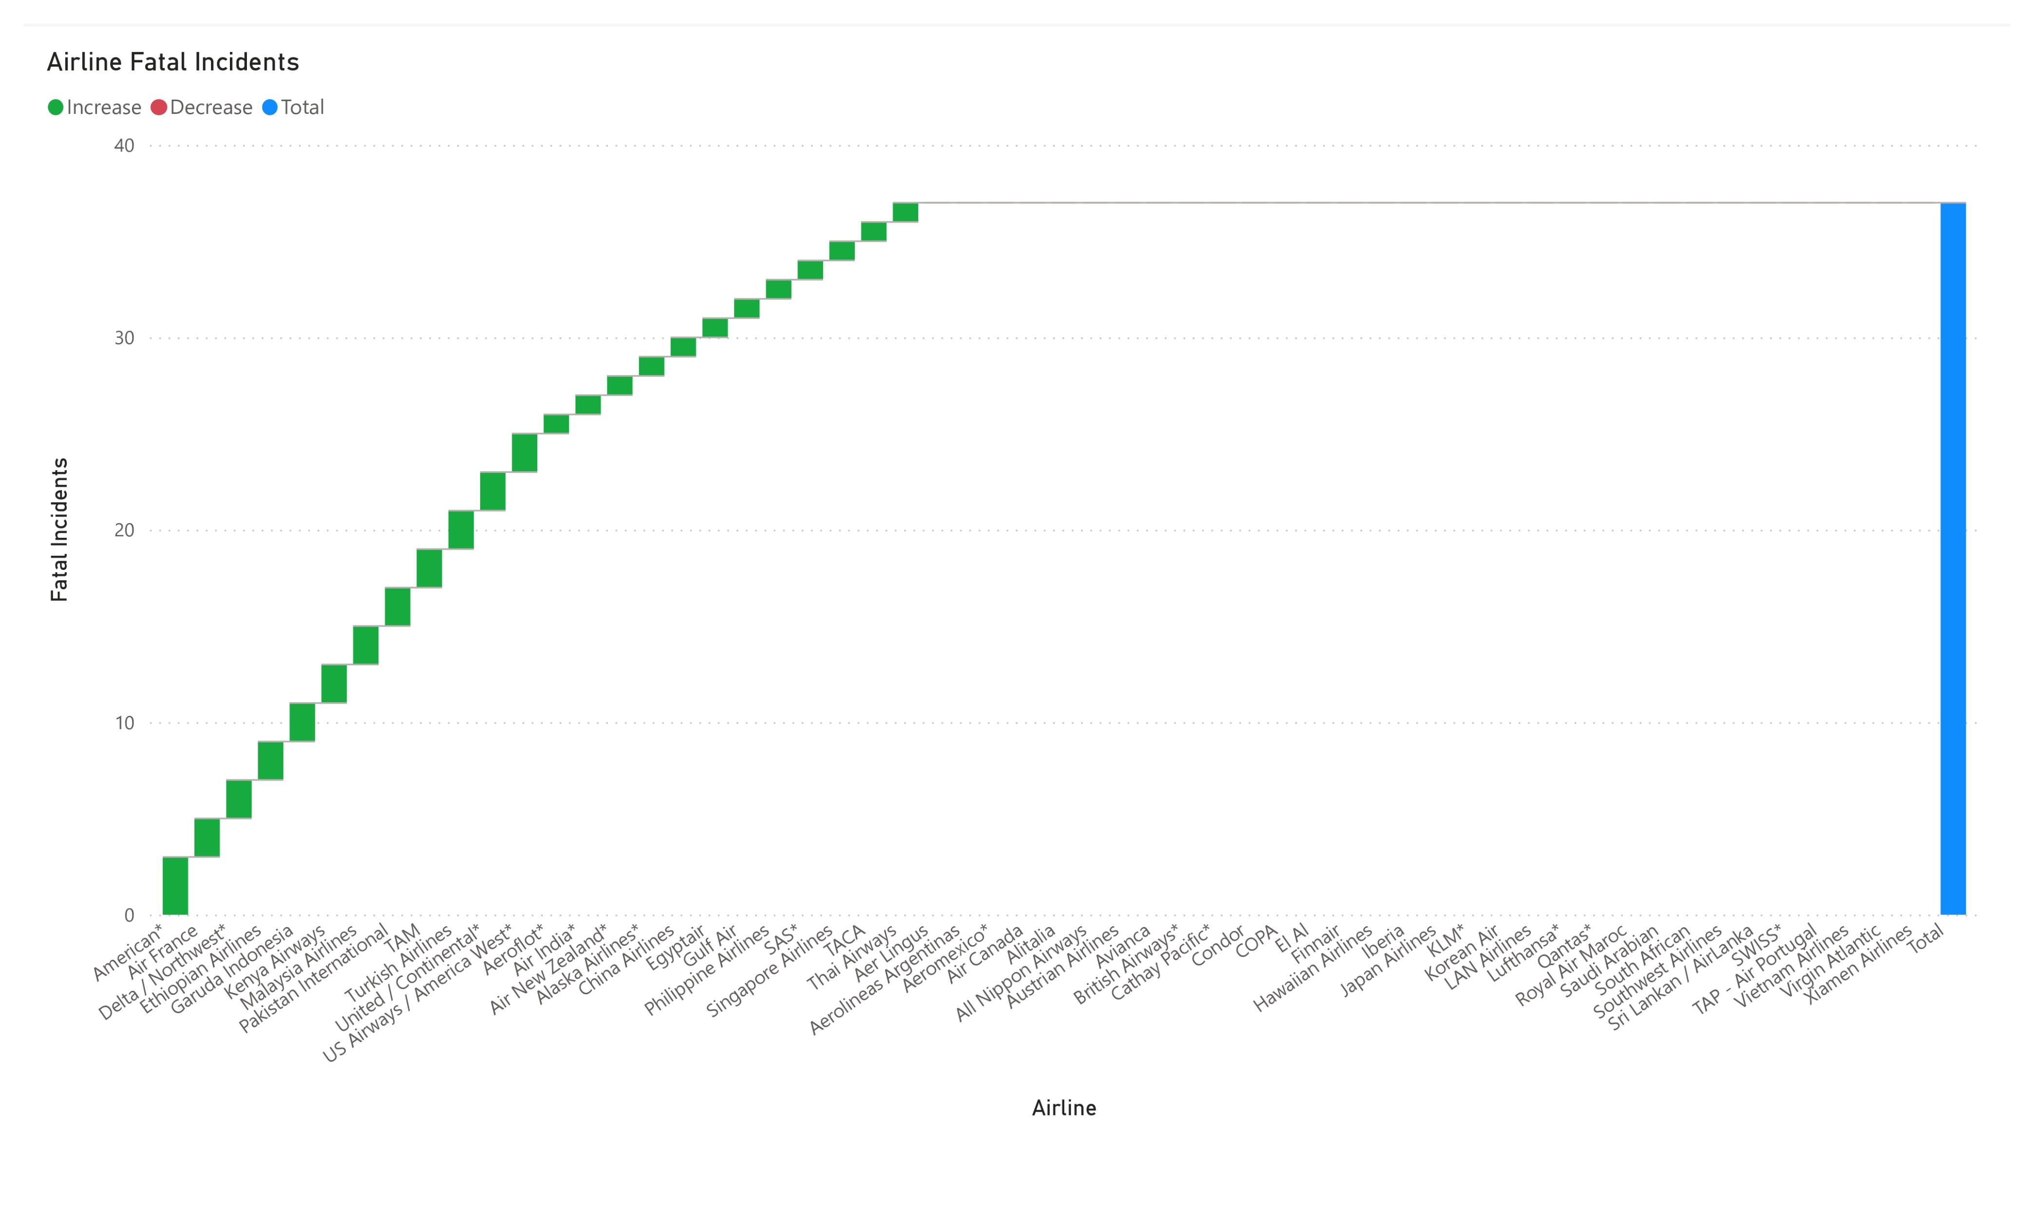
features US airlines having fewer fatal incidents compared to non-US airlines.

Slide 4
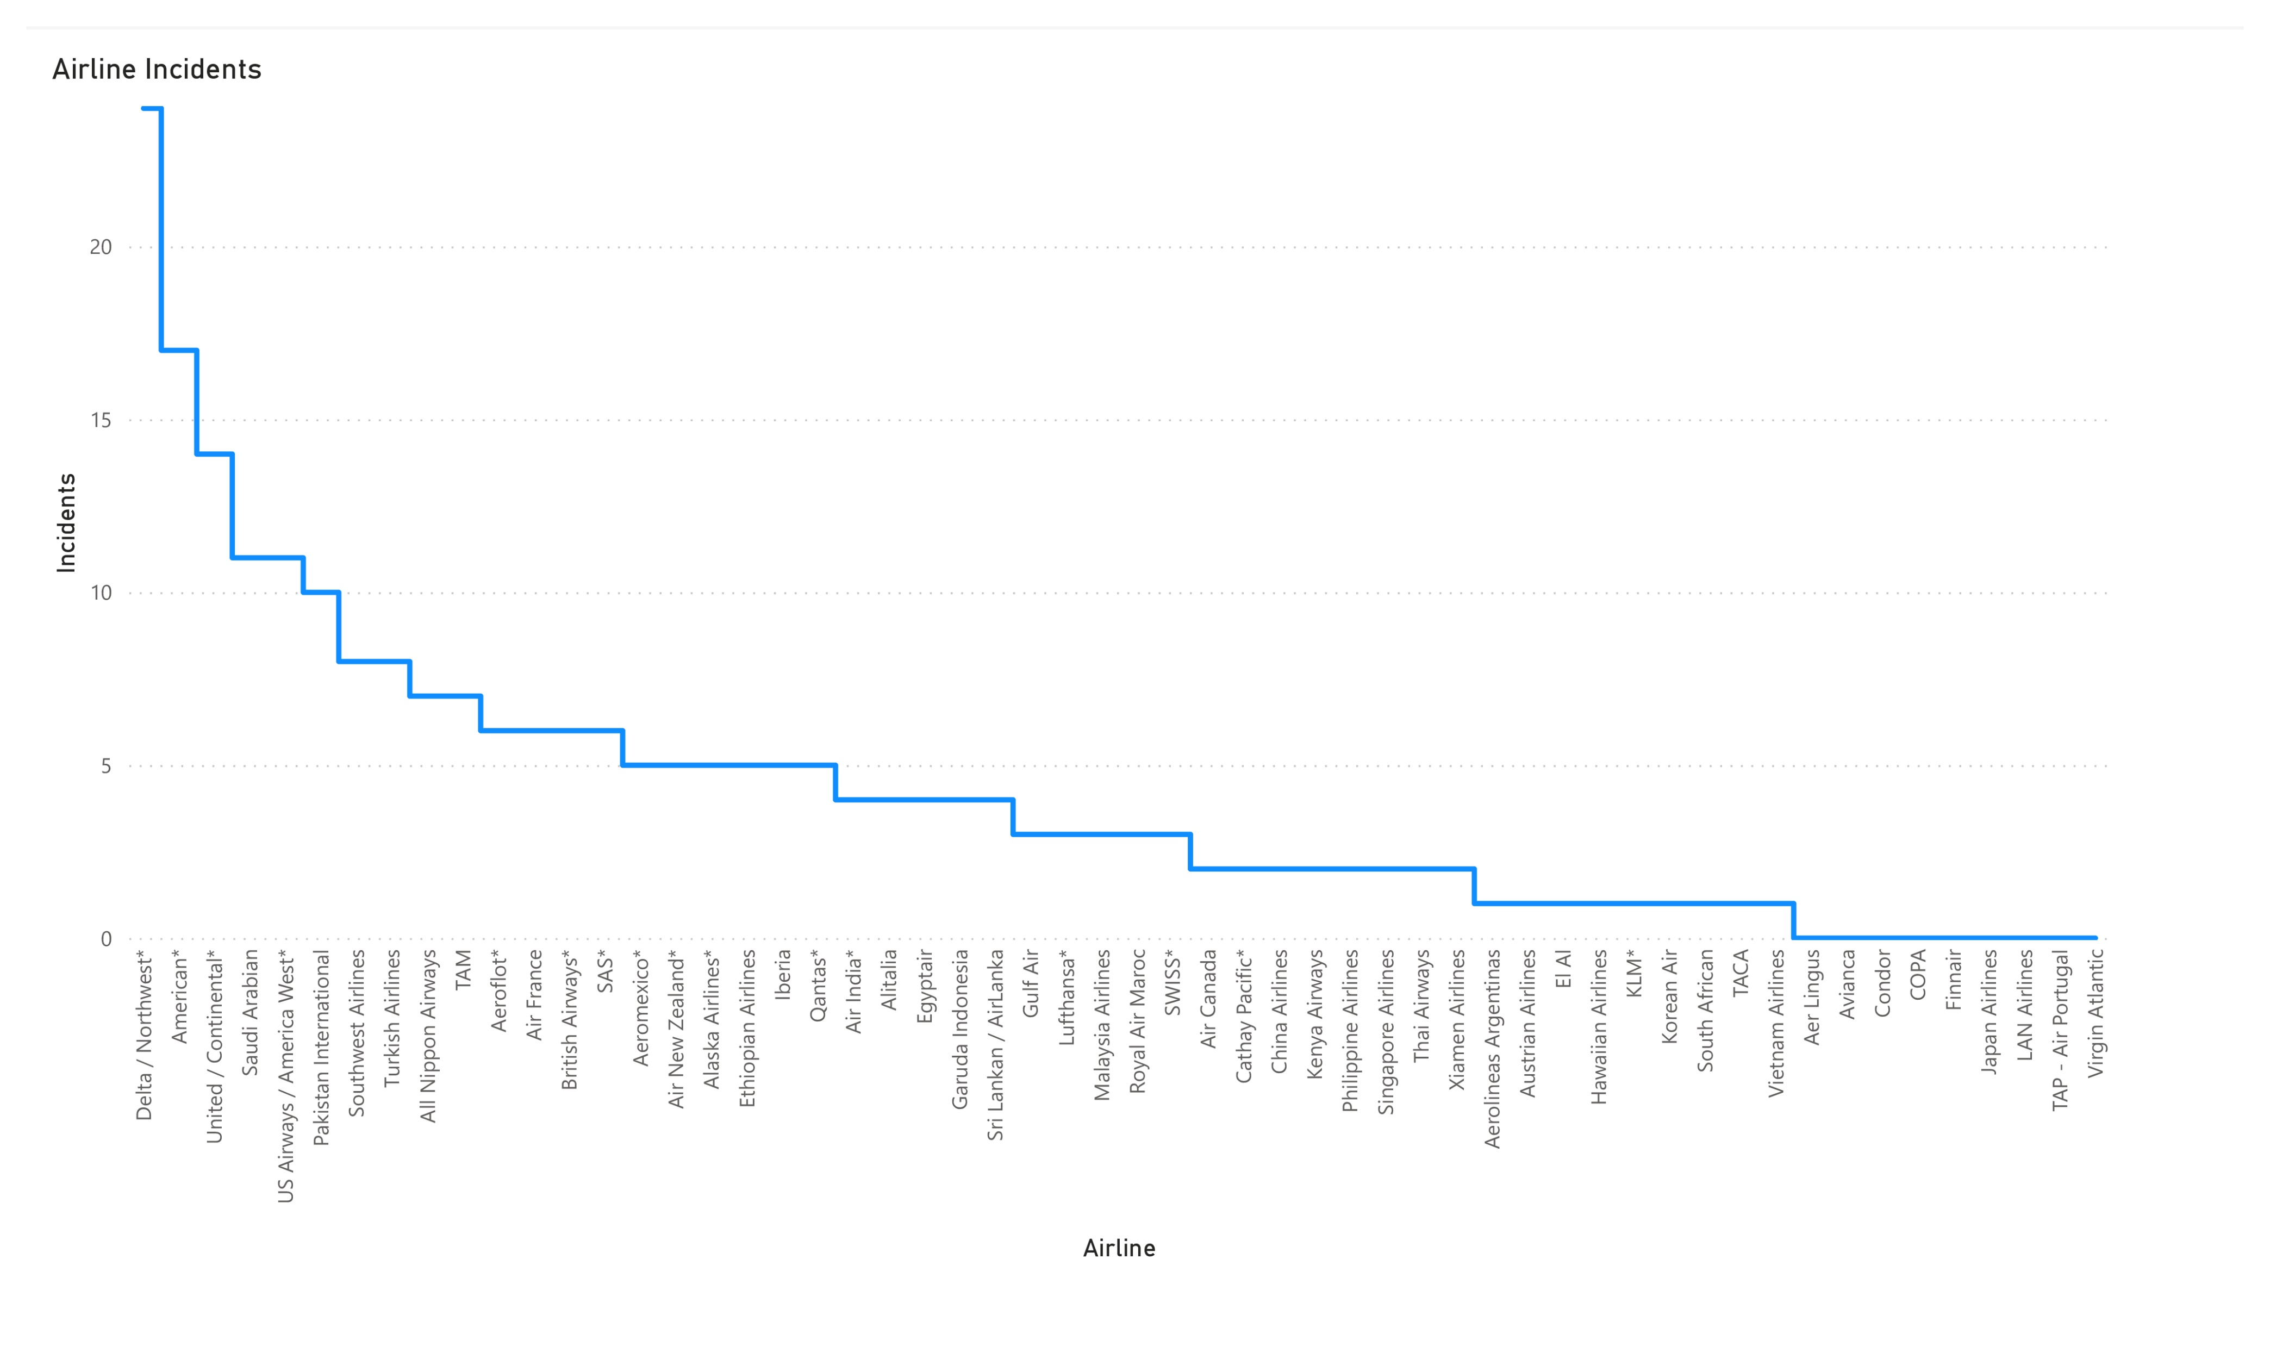
Stages more incidents transpiring In US airlines compared to non-US airlines.

Slide 5
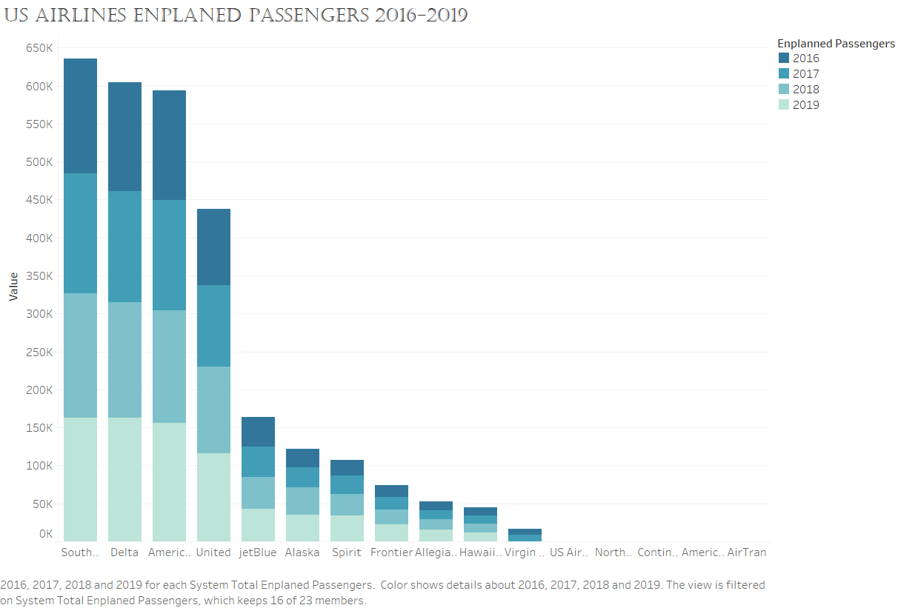
a monumental portion of passengers partaking in flight whether domestically or internationally in the duration of four years.

Slide 6
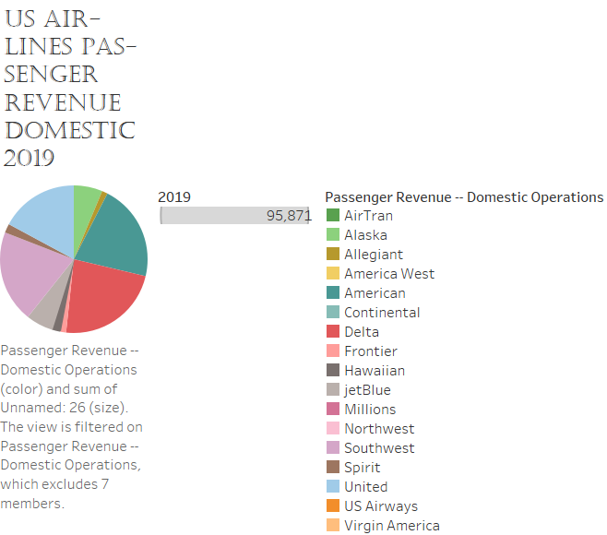
illuminates several US airlines who were flying domestically (within the US) still made a profitable margin of about $96,000.

Slide 7
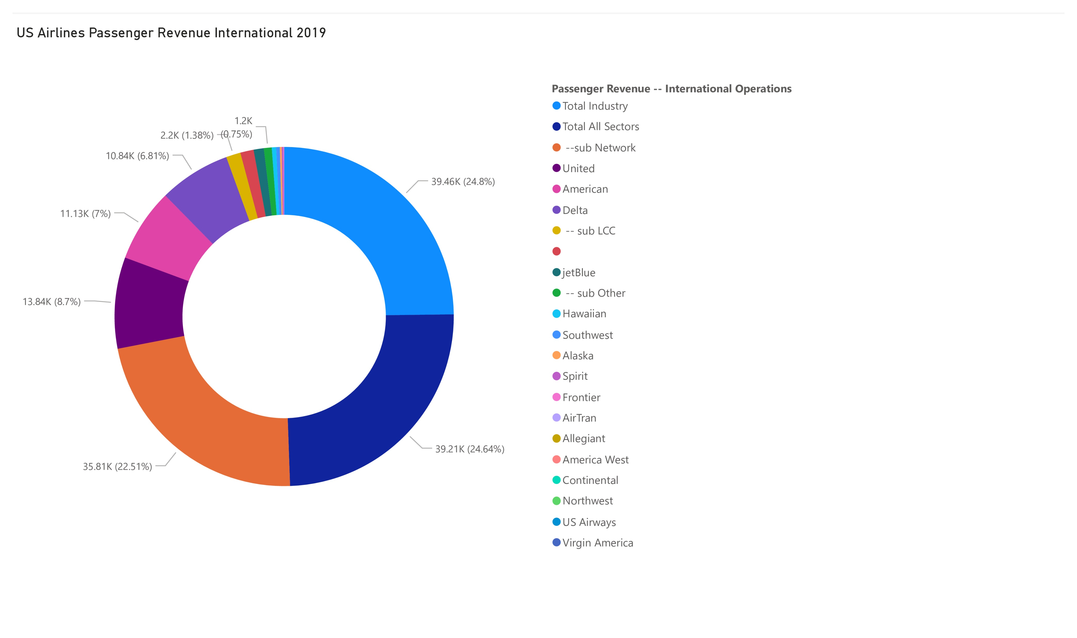
Displays several US airlines who were flying Internationally made a somewhat sizable frame of around $39,000.

Slide 8
Conclusion
Thus, in conclusion, air travel is still a frequent option that patrons utilized domestically and internationally, but will be operated in safer environments of US airlines and more profitable for domestic use, i.e. within the US.

